Slide 1
Nutrition Survey with SMART methods
Training with Mobile Devices

Slide 2
Overview of Training
Working with mobile devices
Contract for mobile device use
How to collect data with mobile devices using ODK collect
Registration
Standardization Exercise
Daily Calibration
Household Interview Questionnaire

Slide 3
Roles and Responsibilities
Trainees will be trained and tested together at the training site. Only the trainees with the demonstrated competences and skills will be hired.
Survey teams will be formed. After training, survey teams will go directly to collect data in the field. Each team will complete about 20 interviews per cluster. The team leader will ensure that data are correctly entered, saved and sent from device to server on a daily basis.
Supervisors and Survey Coordinator will ensure that all teams are well trained and follow the survey methods closely. Supervisors and survey coordinator will be in the field with the teams throughout data collection and provide regular feedback to ensure data quality.

Slide 4
Basic rules of survey
Do not record data on to paper and later onto mobile device.
Always enter data directly onto the mobile device.
Mention any possible exceptions (Households with 30 plus members)
If the survey team notes any special conditions or issues with the interview, record the issue in the final comments section on the ODK questionnaire.
Do not invent or misrepresent any information recorded in the household interview.
If survey team is found to have invented or falsified information, they will be dismissed.

Slide 5
Use and Maintenance of Mobile Devices
The battery life of the device is about 9 hours continuous use and for several days when resting.
The team leader is responsible for charging the battery of device and ensuring that the device is ready for a full day of data collection
Any malfunction of the device should be reported to the direct survey coordinator. Most problems can be resolved over the telephone. The survey supervisor or coordinator can provide a replacement device on demand after review of the problem.
The device must be kept in protective cover, clean and dry and out of direct sunlight and or excessive heat for long periods.

Slide 6
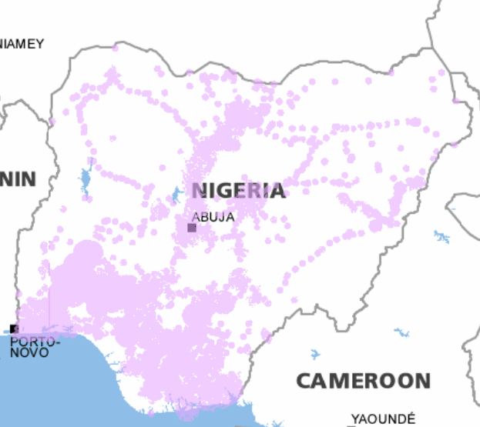
Coverage Areas
Each mobile device will come with a sim card and a data plan. Sending data requires access to the 3G or Edge network.
The team leader is responsible to ensure that data are sent to the survey coordination team every 1 or 2 days.
If data are not sent on a regular basis, the team leader will be alerted. After the second alert, the services of team leader will be reviewed and he or she may be dismissed.
Map of 3G / Edge coverage across Nigeria

Slide 7
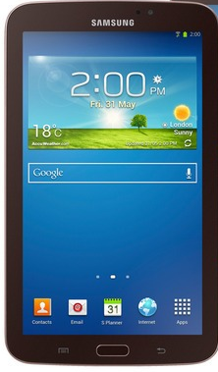
Mobile device utilization policy
Everyone using a mobile device for the survey must sign contract before use of mobile devices
During training, everyone who uses a device will check out and return the device per exercise or daily
Survey teams of three persons take joint responsibility to maintain the device in good condition and protect it from damage
Supervisors or other persons not in a team take full responsibility for the device(s)
Any device damaged, destroyed, lost or stolen will be replaced by those contractually responsible as recorded on the contract.

Slide 8
Rules for use of mobile devices
The mobile device is not your camera, toy, a radio or movie player
If you reformat or attempt to hack the device, you will be dismissed
Do not use the device for personal reasons
Do not show off the tablet during or after data collection
Keep the device in survey bag when not using it in data collection in field
Keep the device in protected case when traveling
You and your team are all responsible to protect device from damage or loss

Slide 9

Collect signed contracts for mobile device use
The form states that the person or persons assigned the mobile device is responsible to maintain the device and components in working condition with no damage.
Collect signed and dated forms from survey personnel and trainees

Slide 10
Assign devices to individuals or teams
Before distribution of mobile devices, ensure that all contracts have been signed and collected first
Assign devices to trainees daily during the training
Collect devices from trainees every day at end of training including all components, such as charge cords (if also distributed)
When all trainees have or share a mobile device, start general overview of use of device.

Slide 11
General instructions for use of device
Turn the Android on and off
Put the Android in sleep mode
Turn the volume up and down
Swipe the screens
Select and open an application
Go to the HOME page
Press Menu button
Press Back button
Do a short press
Do a long press
Notes:
Show the Home button, the Menu button and the Back button

Slide 12
Other tasks for use of device
Turn on and off Maps application
Turn on and off ODK Collect data collection form
Demonstrate number pad
Demonstrate keyboard
Explain question types used in the questionnaire
Yes / No
Multiple choice with one answer
Multiple choice with several answers
Number answer
Text answer

Slide 13
Starting questionnaires
Open ODK Collect and the Survey data entry form.
You are at the start of the Survey form. Tap the arrow
Some questions will demand an answer while others will not
Obligatory answers
Identification such as Team Leader ID, Region Cluster and Household Number
Prompt “Sorry, this response is required!”
Non-obligatory answers
All other variables
Do not leave other variables blank unless there is a valid reason

Slide 14
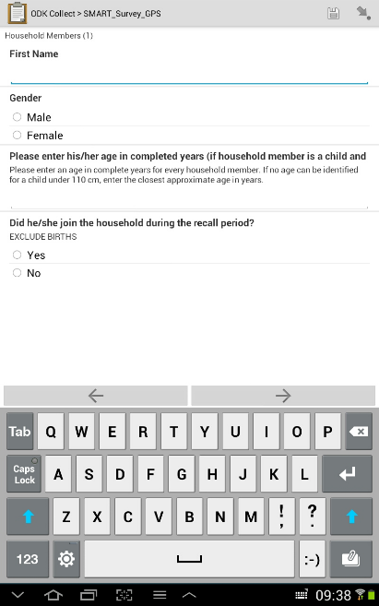
Navigation through questionnaires
Navigate through questionnaire
Click on lower left or right arrows
Go to beginning – Go to end
Click on arrow at top right
Save and exit
Click on disk icon at top right
Use this only when interview is interrupted
Exit without saving
Click on back button lower left
Choose save changes or ignore changes
WARNING all data will be deleted

Slide 15
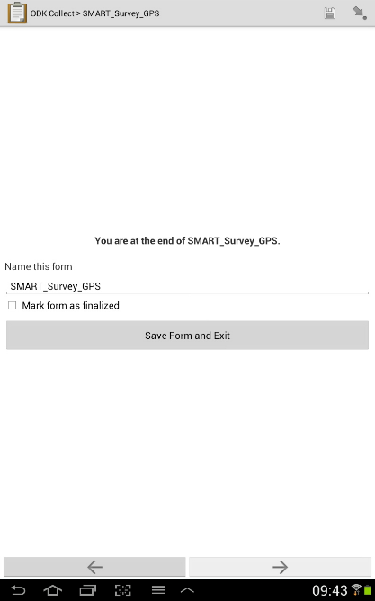
Completion of Questionnaire
Save questionnaire with name
For the survey data entry form always name the questionnaire C (for cluster) the cluster number and H (for household) and the household number. For example, C1H12 (means cluster 1 and household 12)
Mark form as finalized
If questionnaire is completed, check box Mark form as finalized
If questionnaire is not completed, there is a return visit scheduled, do not check box
Click on Save Form and Exit

Slide 16
Registration
Registration
Everyone working on the survey (attending training and survey data collection) must register with the mobile device:
Supervisors
Trainees
Survey Teams
Name
Mohamed
Age
Age
Gender
M
F
Telephone
0801477584657
Email
Email Address

Slide 17
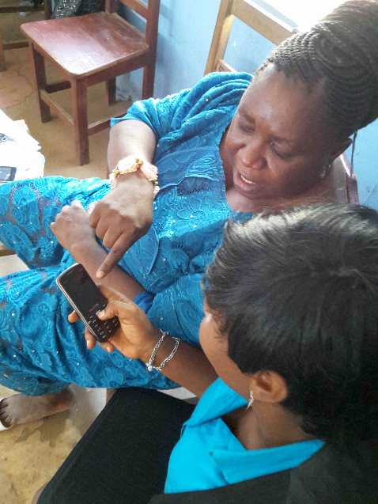
Registration
Open the Registration Form
Enter your family name(s)
Enter your first and middle name(s)
Enter your age in completed years
Enter gender
Enter languages that you speak (check all)
Enter your telephone number
Enter your email address (optional)
Check the box Mark form as finalized
Click Save Form and Exit

Slide 18
Assignment of ID number
ID | Last name | First name | age | gender
1 | Toure | Fatou bintou | 27 | 2
2 | Ba | Adama | 53 | 1
3 | Gueye | Abdoulaye | 60 | 1
4 | Ndao | Cheikh abdoul ahad | 31 | 1
5 | Biteye | Amath | 28 | 1
6 | Malou | Clement francois | 30 | 1
7 | SIMPA | Onesime Louis Bernard | 28 | 1
8 | Seye | Abdou | 30 | 1
9 | Bousso | Souleymane | 27 | 1
10 | Gueye | Adama | 28 | 1
11 | toure | Soukeina | 35 | 2
12 | DIAGNE | Yakhya cherif | 42 | 1
13 | Sagna | Sadibou | 36 | 1
14 | Mansaly | Papa karim | 31 | 1
15 | Faye | Nathalie | 35 | 2
16 | Diallo | Amadou tidiane | 29 | 1
17 | Dansokho | Malamine | 48 | 1
18 | Sao | Lamine | 58 | 1
19 | Diedhiou | Omar | 31 | 1
20 | Mandiang | Binta | 45 | 2
After completion of Registration, everyone will receive an ID number.
The ID number will be used through out the survey to identify one person.
You are responsible to remember your ID number.
If you do not record your ID number correctly during training and data collection, you may not be selected as a data collector or your salary may be reduced.
Notes:
Download the registration form data into excel . Add a column on the left of the excel spreadsheet. Add a running number to the column. Use these numbers as the ID numbers for each survey personnel.

Slide 19
Standardization Exercise
All trainees who will measure heights, weights and MUACs must complete the standardization exercise with acceptable accuracy and precision.
All measurements will be conducted by a team of two persons, both in the standardization exercise and in the survey data collection.
If you record a measure that you did not take (cheating) or help others to record measures that they did not take (copying), your participation / employment will be terminated immediately.
The configuration of tablets is slightly different for the standardization exercise.

Slide 20
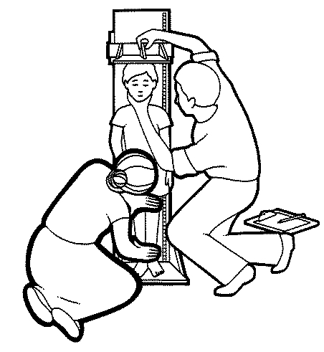
Standardization Exercise
Session number
The survey coordinator will number each standardization session (1,2,3…). Each session takes about 4 hours. It is bad practice to have more than one session at a time.
ID Measurer
The measurer will take measures of 10 children. When entering data on each child, the measurer will record their ID number.
ID Assistant
The measurer will also record the ID of their assistant. The measurer and assistant must work together with care to ensure accurate measures.

Slide 21
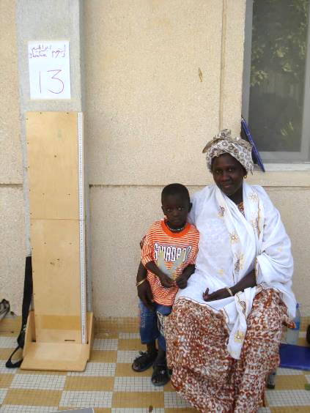
Standardization Exercise
In the large hall, there will be one child and guardian per post. Also there will be one scale, height board and MUAC strip at each post. At the post, the following information is recorded
Post number
Name of child
Sex of child
Age of child (completed months)
Notes:
Standardization exercises should be implemented in a large hall where all 10 teams are visible to facilitate supervision. Standardization exercises should not be conducted in a village environment as supervision is difficult or impossible.

Slide 22
Standardization Session
The measurer is responsible to:
Enter identification data of session and post
Measure child
Enter child’s measurements onto mobile device.
The assistant is responsible for:
Helping the measurer to make accurate measures by
Holding feet or head of child on height board
Ensuring child is weighed naked (or light underpants if naked is not possible)
MUAC measures are made correctly
Measurements are entered correctly on the mobile device.

Slide 23
Standardization Session
At each of the 10 posts, the measurer will complete the standardization exercise questionnaire .
When the measurer has completed all measures of the child at the post and entered the data, he or she will click on Save Form and Exit
It is not necessary to name the saved form as it will be sent to the server immediately.
The option Mark form as finalized is not available during the standardization exercise.

Slide 24
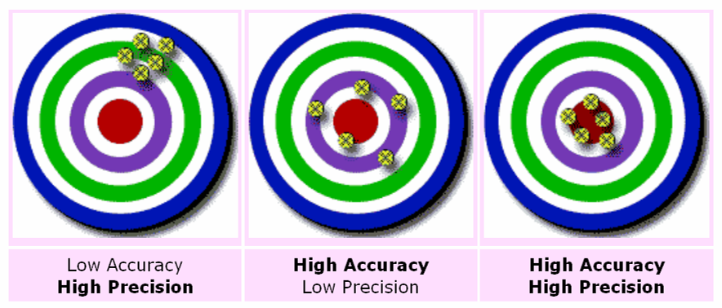
Standardization
On completion of the standardization session, the results are presented. If a trainee did not achieve acceptable accuracy or precision, he or she will have to repeat the standardization exercise.

Slide 25
Practice data entry for Standardization
Before starting the standardization session, practice data entry of:
Session number (0)
ID measurer
ID assistant
Post #, child’s name, sex and age in months
Height, measure, weight and MUAC
And send the completed data entry form
Notes:
When only practicing the data entry – not during the standardization session – use Session number 0 zero.

Slide 26
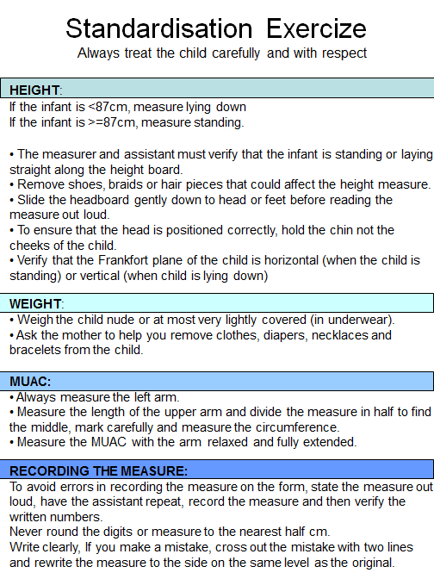
Complete Standardization Session(s)
After anthropometry training
Notes:
When only practicing the data entry – not during the standardization session – use Session number 0 zero.

Slide 27
Daily Calibration – Identification
Every day during data collection the team must complete the daily calibration form.
The entry of ID numbers of team allows the coordinator to know who is working where and when.
Enter the:
ID of Team Leader
ID of 1st Anthropometrist (person who measures most often)
ID of 2nd Anthropometrist (person who assists most often)
Confirm the team members.
Notes:
Remind the trainees that they need to enter their IDs correctly. If they make mistakes, the data will show that they did not work. If they did not work, they will not get paid.

Slide 28
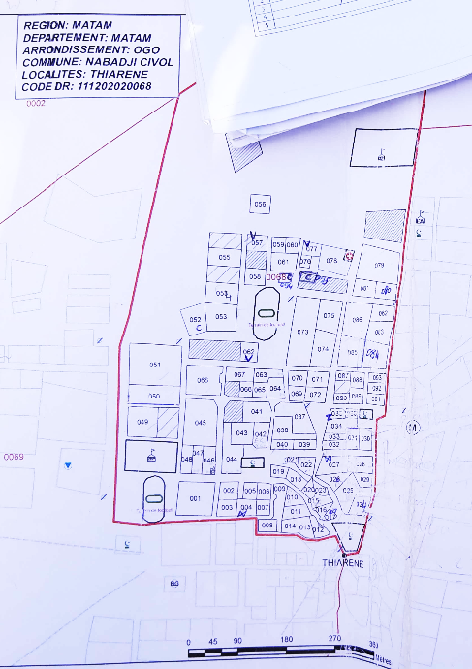
Daily Calibration
Cluster Information
Number of households in cluster
Total population of cluster
Segmentation of cluster (Yes / No)
Number of households in segment
Population in segment
Follow the questionnaire and enter the data that are available.
Notes:
If some of the data are not available, leave the cells blank.

Slide 29
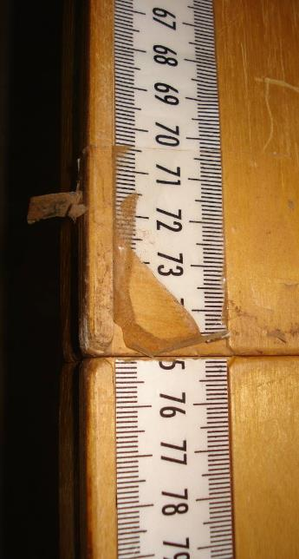
Daily Calibration
Before completing the calibration of measurement tools. Review all the anthropometry equipment to ensure that it is functioning and not broken.
If there are tools damaged or non-functioning, exchange the tool for your reserve tool and alert the survey supervision staff.

Slide 30
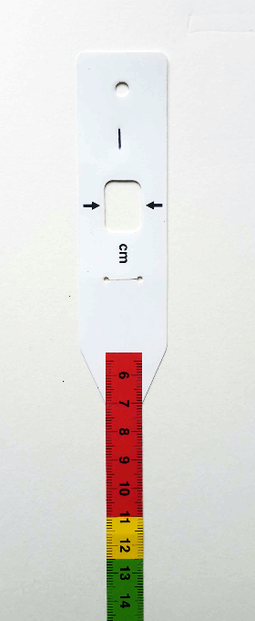
Daily Calibration
ID #
To complete the daily calibration, record the ID number of tool.
Every height board, scale and MUAC strip is numbered.
Measure the tool with its provided standard length, weight or circumference.
Record the measure in the daily calibration form.
MUAC strips become creased and damaged easily. Exchange the MUAC strips on a daily basis if they are slightly creased or damaged.

Slide 31
Household Questionnaire
Identification variables
Team leader ID # - The team leader is responsible for the work of the team, so the team leader ID is always used to identify the team.
First Administrative Area – Select the name of the region, province or county
Cluster number – this number will be available on the cluster assignment sheet and the cluster map

Slide 32
Household Questionnaire
Approach the door to the household, concession or building. Record the household number(s) on the door with chalk. Circle the household number(s) selected for interview.
If no household is selected, continue to the next household.
If there is a household selected – record the GPS outside the door
Identify the head of the household or adult and request consent to conduct the interview.
Notes:
In the daily analysis of data, we will review the the number of refusals. IF there are more refusals to be interviewed in one team than normal, then they will be given special attention to ensure that they conduct the survey correctly.

Slide 33
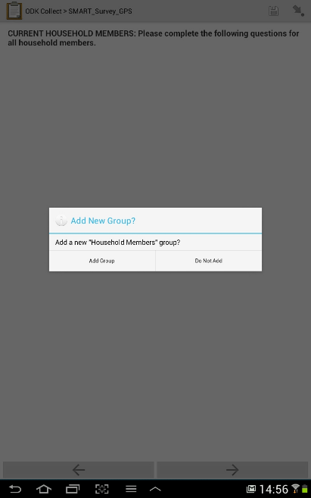
Household Questionnaire
On the page labelled
CURRENT HOUSEHOLD MEMBERS: Please complete the following questions all household members.
Click the arrow on the lower right corner
At the prompt Add New Group? Add a new “Household Members” group?
Click Add Group

Slide 34

Household Questionnaire
On the household member data entry page, enter:
Name or nickname. This is only for you to identify the person in the household. It will be deleted from the data later.
Gender of household member
Age in completed years of the household member
Did he/she join the household during the recall period ?
Notes:
Emphasize here that the household listing collects age always in completed years.
Later in the child section, we will collect more precise age information (birthdate or age in months)

Slide 35
Household Questionnaire
To add another member, click on the arrow on the lower right corner of the screen. Click on Add One More Group?
In the household listing, list members in the order below:
Head of household
His or her partner
Children of head of the household
Other older household members
Other younger household members
Notes:
Continue to add another group until all household members are listed.

Slide 36
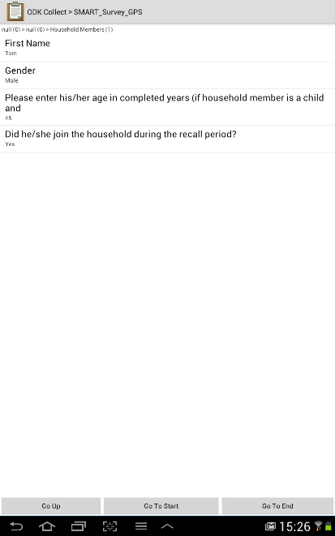
Levels of Questionnaire
The Add New Group is the most complex detail in ODK Collect.
This function is used for collecting repeated data such as for a list of household members.
In ODK terminology, you go down into a list, and you go up to return to the main questionnaire.
When you click on the arrow on the top right of the screen, you can go down into a list and go up to the main questionnaire.
Notes:
Practice using the arrow on the top right of the screen to navigate to specific household members (1st, 2nd, 3rd, etc…)

Slide 37
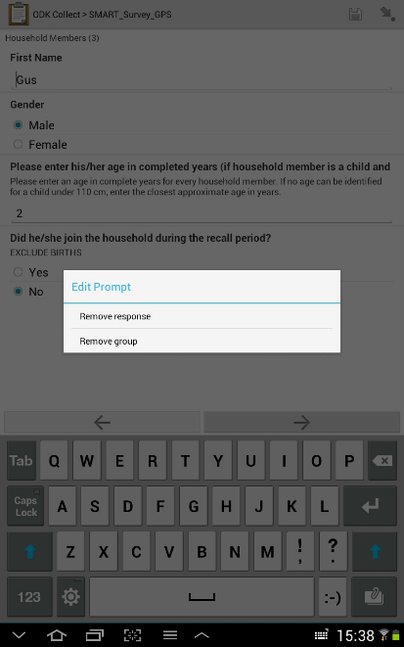
Household Questionnaire
If you make a mistake in the household listing and want to remove a household member:
Go to the data entry page for the household member that you would like to remove.
Long click on the name or any variable on the page.
At the Edit Prompt
Click Remove group
At the Remove this Group? prompt
Click Remove group – to confirm
Notes:
If there is a problem to delete the household member data / remove this group, the interviewer can delete the name, sex, age and arrival data from the page. The survey analyst will interpret a household member / group with no name, sex, age or other data as a deleted case.

Slide 38
Household Questionnaire
After completing the household listing (current household members), following the questionnaire, ask the head of household or respondent politely about
Household members who moved away (recall period)
Household members who died (recall period)
Make a list of all household members who moved away during the recall period using the Add New Group, similar to the household listing.
Make a list of all household members who died during the recall period always using the Add New Group function.
Notes:
Again to make any corrections to the lists of household members who moved away or died, follow the same technique as shown in the household listing.

Slide 39
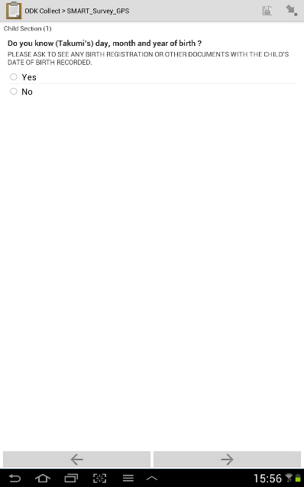
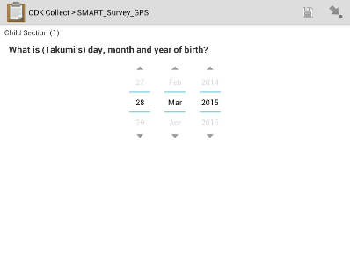
Child Section
The children from the household listing are automatically selected for questions in the child section.
More precise age information is needed for all children 5 years or younger.
Ask the respondent for a birth certificate or any record with the birthdate recorded. Verify that the birth date is correct.
Enter the birthdate with the date slider. Be careful not to enter the wrong date.
Notes:
Please show that the questions on right of screen are on two separate pages.

Slide 40
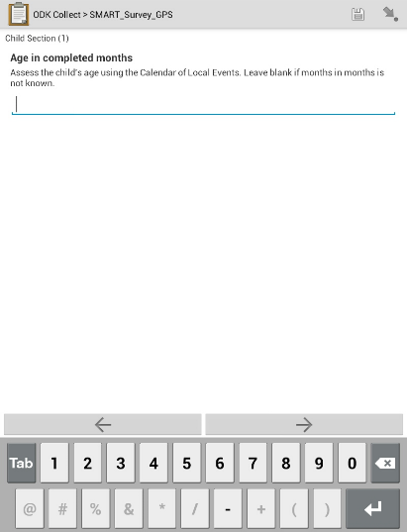
Child Section
If the date of birth of the child is not known, then use the calendar of local events to determine the child’s age in completed months.
Use the sandwich technique to ensure that the child was born before a recognized date or activity and after a different date or activity.
Record the age in months as precisely as possible.
Notes:
Please show that the questions on right of screen are on two separate pages.
If the respondent cannot help to determine the child’s age in months, the cell can be left blank.

Slide 41
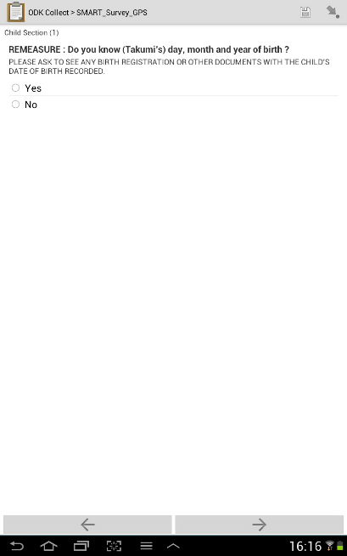
Child Section
Measure and enter weight, height, measure, MUAC and bilateral oedema status.
Enter the data carefully without mistakes.
If there is possible mistake (anthropometry measures are outside the WHO flags), then you will be asked to make a Remeasure
Assess the age of the named child, and remeasure and enter weight, height, measure, MUAC and bilateral oedema status.

Slide 42
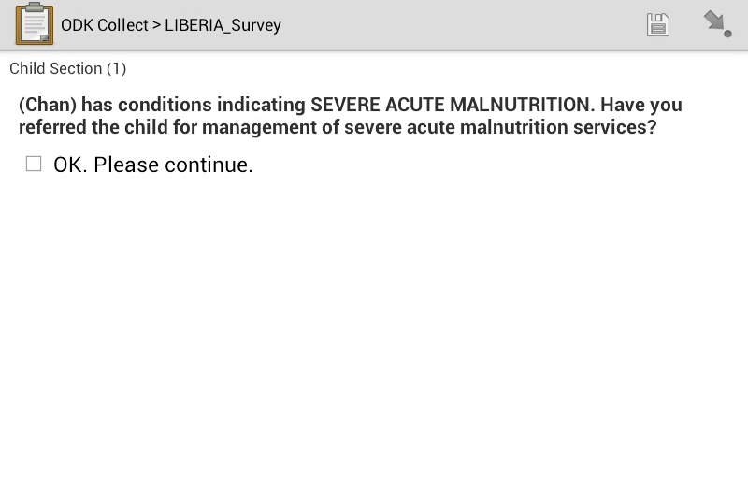
Referrals for severe acute malnutrition
The calculations for detection of SAM and MAM are integrated into the household questionnaire.
If a child is detected to be:
Severely wasted (WHZ <-3SD)
Severely wasted (MUAC < 115 mm)
Suffering from bilateral oedema
There will be a note to complete
a referral form and ensure that
the child is treated.

Slide 43
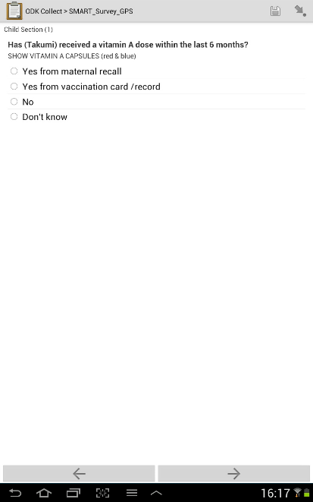
Child Health Questions
Ask the respondent for a child health card or vaccination record. You will collect information on :
Vitamin A Supplementation in past 6 months
Deworming in past 6 months
Measles vaccination in past 12 months.
If the answer is yes, record the source of information, from maternal recall or from the vaccination card / record.

Slide 44
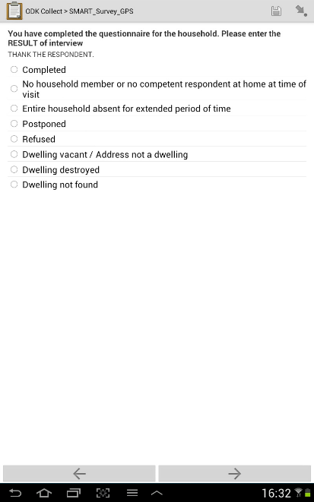
Completion of Questionnaire
When you complete the interview, record Completed on the Result of Interview page.
If there is a reason why the interview was not conducted, select and check the correct reason.
Notes:
With the systematic random selection / List and Go , there should never be any of the last three responses – 1) Dwelling vacant / Address not a dwelling, 2) Dwelling destroyed, 3) Dwelling not found.

Slide 45
Completion of Questionnaire
RESCHEDULED INTERVIEW
If you cannot complete the questionnaire and schedule a return visit to measure missing children,
On the Notes page, record time for return visit
On the Result of Interview page, record Postponed
Save the questionnaire following the recommended format (C1H10) Cluster # HH #.

Slide 46
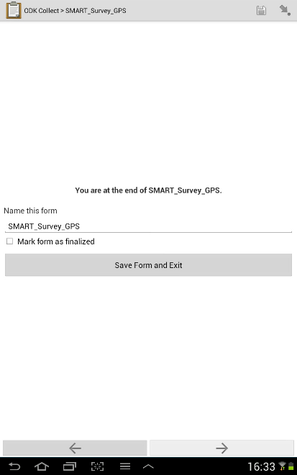
Questionnaire Completed
When the interview is completed :
Click Mark form as finalized
Press the Save Form and Exit button
The form has to be named if it is saved on the mobile device.
Notes:
If the « Delete form when finalized and sent » option is selected, the questionnaire will no longer be available on the device for review.

Slide 47
Typical problems encountered in the field
Data entry form closes accidentally
Close the data entry form in mid interview. Hit the home button, run another program, then open the data entry form again.
On re-entry, the screen may show:
- the main menu,
- a screen from the last survey
- or possibly the collected data was lost.
Demonstrate how to deal with each case and emphasize the importance of completing and submitting your survey.

Slide 48
Typical problems encountered in the field
System Crashes
Any app can crash. encourage the trainees to explore the device. If they find errors and other problems, show these error messages to everyone and demonstrate the appropriate response to this type of error.

Slide 49
Reminders for data collection
Complete daily calibration of tools and log-in every day before data collection
Do not skip questions, review data entry form for completeness
Complete the data entry on one household before starting the next
Remind yourself of the household number by the number recorded on the door of household written in chalk
Save your data if you are interrupted in mid interview
Save the household questionnaire with standard format with cluster and household number (C1H12) if you do not complete the survey on first try.

